Slide 1
Challenges in Applying Mixed-Criticality Systems to Aircraft Engine Control Systems
Stephen Law, Rolls-Royce
Iain Bate, University of York

Slide 2
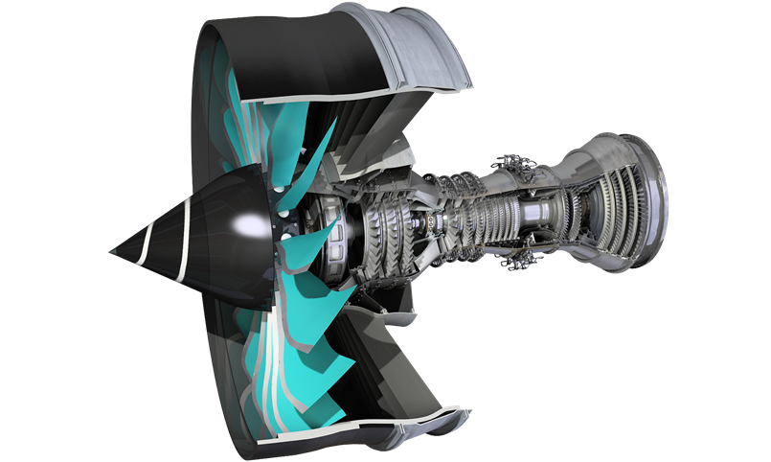
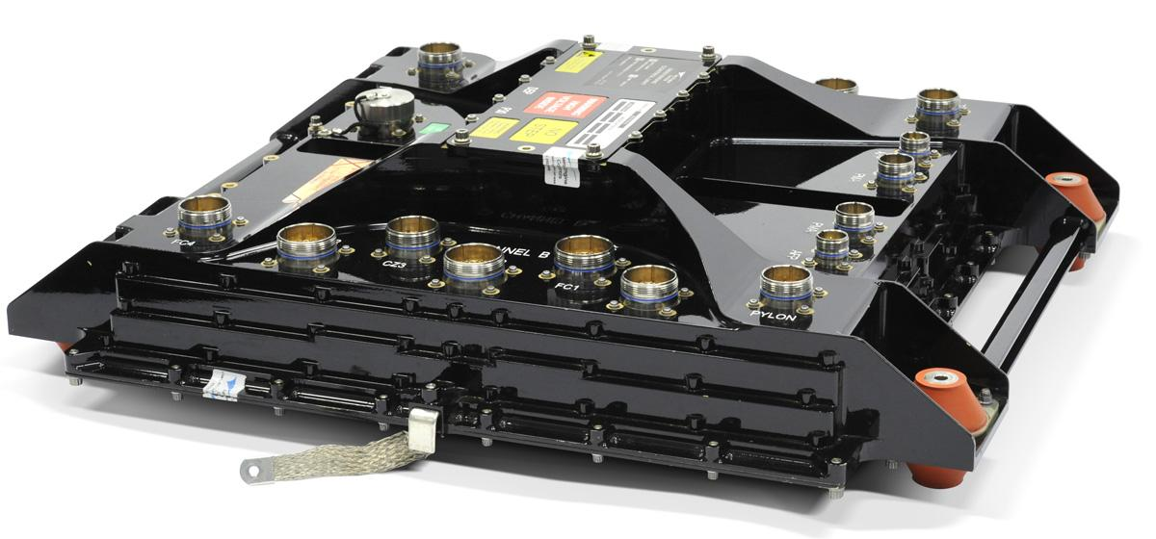
Introduction
Rolls-Royce Control Systems develop DO-178C DAL A, C and E software to control (DAL A) and monitor (DAL C/E) Rolls-Royce aircraft engines.
All on single core processor devices
Rolls-Royce has had a close collaborative relationship with the University of York for the last 25 years
Most recently in the SECT-AIR and ENCASE joint research programs

Slide 3
Why is Mixed Criticality Appealing?
WCET processes are pessimistic, but we would struggle to prove this to a certification authority
Can we better use this ‘spare’ utilisation?
Mixed Criticality Scheduling allows low criticality tasks to execute on the same target hardware as high criticality tasks
Allowing low criticality tasks to have deadlines, periods and timing requirements
Giving a good balance between safety, flexibility and maximising utilisation
Additionally we have a number of tasks we would consider to be high criticality however we can afford for them to be disabled for short periods of time.
For instance recording error logs in non-volatile memory, a time consuming but still important process.
Principal benefits – Cost & Flexibility.
Notes:
Vestal’s work noted that low DAL tasks have been developed against lighter standards, therefore we have less confidence in their WCET
We would extend this to also state we have less confidence in their correct operation
However the potential uses for MCS go beyond simply supporting ‘less important’ tasks.
We have a number of tasks we would consider to be high criticality, because of the effect their failure would have the on the system, however we can afford for them to be disabled for short periods of time. For instance recording error logs in non-volatile memory, a time consuming but still important process.
Therefore it is very important that we address exactly what we mean by a ‘low-DAL’ task
Ultimately it provides two main advantages - cost reduction and flexibility
Less processors, easier proof of schedulability

Slide 4
The Vestal Model
Introduces the notion that confidence in a software task’s WCET – C – is proportional to its criticality
Higher criticality. Higher analysis effort. More pessimistic WCET
C_{A} ≥ C_{B} ≥ C_{C} ≥ C_{D} ≥ C_{E}
Focusing on a dual criticality system…academic works and models that build off Vestal’s seminal work essentially treat each task as having a WCET for each criticality
High DAL tasks => C_{HI} and C_{LO}
Low DAL tasks => C_{LO}
The question is how to utilise the spare execution time – [C_{HI} - C_{LO}]
Notes:
Vestal’s work noted that low DAL tasks have been developed against lighter standards, therefore we have less confidence in their WCET
We would extend this to also state we have less confidence in their correct operation
However the potential uses for MCS go beyond simply supporting ‘less important’ tasks.
We have a number of tasks we would consider to be high criticality, because of the effect their failure would have the on the system, however we can afford for them to be disabled for short periods of time. For instance recording error logs in non-volatile memory, a time consuming but still important process.
Therefore it is very important that we address exactly what we mean by a ‘low-DAL’ task
Ultimately it provides two main advantages - cost reduction and flexibility
Less processors, easier proof of schedulability

Slide 5
Industrial Point of View
Vestal’s work noted that C_{LO} is obtained against lighter standards, we have confidence in it but we cannot prove it to be sound.
We have developed/tested a low DAL task to the same standard as high DAL task, but gathered less evidence of integrity
Partitioning must be employed
It is very important that we address exactly what we mean by a ‘low-DAL’ task
What tasks/operations are appropriate/safe as ‘low-DAL’ tasks?
Equally we need to understand the importance of C_{LO} and C_{HI}
What restrictions and requirements do these measures place on system integrators?
Notes:
Vestal’s work noted that low DAL tasks have been developed against lighter standards, therefore we have less confidence in their WCET
We would extend this to also state we have less confidence in their correct operation
However the potential uses for MCS go beyond simply supporting ‘less important’ tasks.
Therefore it is very important that we address exactly what we mean by a ‘low-DAL’ task

Slide 6
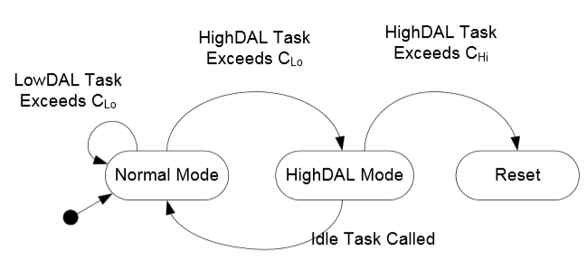
Current State of the Art - Our Understanding
We have primarily studied AMC+ and the Robust System model
Both models have been implemented around our aircraft engine control system
The robust model is gives controlled graceful degradation
It allows resilient tasks to exceed C_{Lo} a bounded number of times before HighDAL mode is entered
Notes:
Remind that AMC will never come back from HighDAL mode

Slide 7
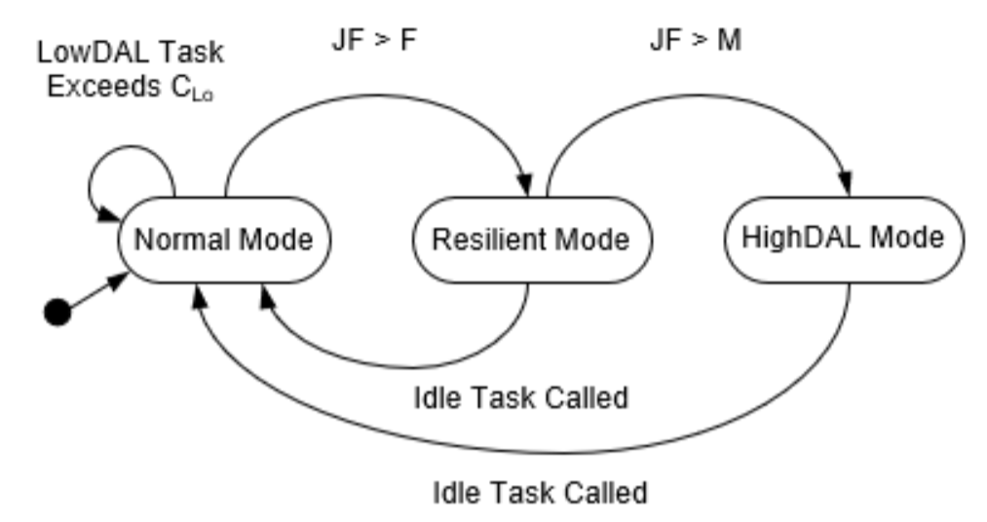
Robust Mixed Criticality
A robust task is one that can safely drop a non-started job
A fault is measured when one task overruns its C_{LO}
JF Records the number of Job Failures
An error is registered when one or many tasks fail to comply with their timing requirements
A resilient system is one which employs graceful degradation (if necessary through the control of robust tasks) in order to cope with one or many faults, thus aiming to avoid errors.
Notes:
Remind that AMC will never come back from HighDAL mode

Slide 8
Robust Mixed-Criticality
Normal mode
F hi-criticality tasks can exceed C_{LO}
Resilient mode
Up to M tasks can exceed C_{LO}
Each robust task can skip up to S jobs
High-criticality mode
Low-criticality tasks are not released
On an idle tick the counters for jobs skipped (JF) are reset
If C_{Hi} is exceeded then there is a power cycle

Slide 9
Results From Porting Existing System
An existing Rolls-Royce control system was ported to the Robust Mixed Criticality model.
>40% additional utilisation
Identification of C_{LO} and C_{HI} aligned well to our processes
In particular we studied the application of a monitoring task responsible for writing to NVM
Robust and low-DAL
Responsible for writing data from a queue to NVM
Able to drop some jobs, then need to run normally to catch up
Can we be confident its write queue will not overflow?
Notes:
Remind that AMC will never come back from HighDAL mode

Slide 10
Assessing Low Criticality Service
Current static schedulability analysis confirms
High-criticality tasks always meet their deadlines
Low-criticality tasks meet their deadlines when jobs are released and completed
If jobs are allowed to be skipped, then the number is bounded
Many academic papers have looked at improving low DAL service
None (to our knowledge) have identified ways to quantify it
We want to know
What is the minimum gap between entering high-criticality mode?
The max jobs skip allow us to guarantee from a normal level the buffers don’t overflow
The minimum gap then allows us to guarantee the buffers return to normal
Notes:
Remind that AMC will never come back from HighDAL mode

Slide 11
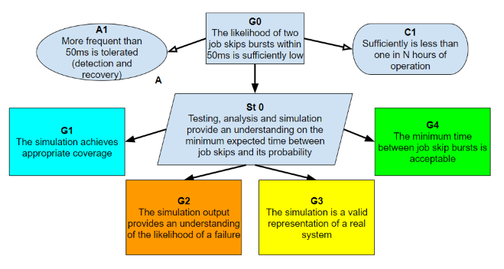
Assessing Low Criticality Service
A GSN supported statistical approach built around a scheduler simulator, seeded with real data, and updated throughout the software development process
Acceptability
Confidence
Correctness
Likelihood
Notes:
Remind that AMC will never come back from HighDAL mode

Slide 12
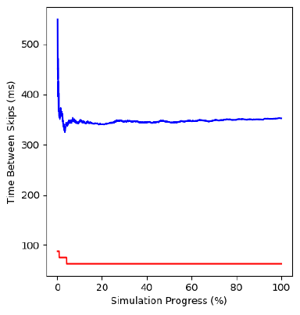
Confidence
Assessing Low Criticality Service
Using a scheduler simulator allows early design time analysis
Simulator uses real execution time profiles
How can we have confidence that the simulator has observed a large enough sample of the search space?
How can we have confidence that continued testing will not reveal new results?
Blue line is the average
Red line is the minimum
Notes:
Remind that AMC will never come back from HighDAL mode

Slide 13
Assessing Low Criticality Service
Confidence
Simulations parallelised so significant data can be obtained
Rather than just looking at the results convergence was assessed
Take X% of the simulation results and compare to the rest
Use confidence intervals
How confident we are that the minimum gap is greater than Y%?
and chi-squared test
Do the same come from the same distribution?
and Earth Movers Distance
How different are the distributions?
Notes:
Remind that AMC will never come back from HighDAL mode

Slide 14
Likelihood
Assessing Low Criticality Service
How often do we come close to seeing an error?
If an error has been observed, what is its frequency of occurrence?
If an error has not been observed, use a fitted distribution to assess an exceedance probability
Notes:
Remind that AMC will never come back from HighDAL mode

Slide 15
Correctness
Assessing Low Criticality Service
How can we be sure the simulation is correct?
Simulation offers a route to fast, iterative, repeatable testing… provided the simulation is correct
Seeded and configured with real system parameters
Real task attributes
Execution times for tasks obtained through systematic testing
Accurate model of the scheduler including overheads
As control system matures, the simulation is supplemented with, and reviewed against real test campaign data
Notes:
Remind that AMC will never come back from HighDAL mode

Slide 16
Acceptability
Assessing Low Criticality Service
Are the results acceptable?
Our case study identified that 40% additional utilisation could be added to the process, which could be expected to complete its operation, without error, in 99.995% of cases
But… that’s potentially 360 low DAL timing errors per hour…
Is this good enough…?
Depends on the task’s system requirements
If not, the system can be refined, with the simulation easily repeated. Hopefully, at an early point in the design lifecycle
Notes:
Remind that AMC will never come back from HighDAL mode

Slide 17
Conclusions
The potential for utilising mixed criticality scheduling techniques is high
Cost and flexibility
However, the academic literature (to our knowledge) does not presently offer ways to quantify, or prove, the service afforded to low DAL, or robust, tasks.
This paper has integrated a robust mixed criticality scheduler with a real industrial control system, presenting real world results
The paper suggested an approach that could be used to allow a system integrator to gain confidence
Notes:
Remind that AMC will never come back from HighDAL mode

